Slide 1

Project: E-Learning Platform Management System
SUBMITTED BY :
NAME : Sudhanshu ( 2K22/CO/457)
Suryaansh Tomar. ( 2K22/CO/461)
Hitansh (2K22/CO/212)
Proff. Rohit Beniwal

Slide 2




Introduction
Introduction
Project Overview: Development of a scalable, efficient database management system for an e-learning platform.
Importance: Handles diverse data types, ensures data integrity, security, and quick access for millions of users.

Slide 3


Problem Statement
Growth of E-Learning: Increased demand for robust database management systems.
Challenges: Managing user-generated content, ensuring data integrity and security, real-time data updates, and reliable performance.

Slide 4


Motivation
Practical Experience: Gain hands-on experience in database design and implementation.
Real-World Application: Understand DBMS applications in large-scale platforms.
Optimization Techniques: Explore performance and scalability enhancements.

Slide 5



Objectives
Scalable Schema Design: Efficiently handle data entities (students, instructors, courses, assignments).
Data Integrity: Maintain consistency across the database.
Performance Optimization: Use indexing, normalization, and query optimization.
Support User Interactions: Enable registration, assignments posting, comments.
Security and Privacy: Implement robust security measures.

Slide 6


System Requirements
User Registration and Authentication
Student Profile Management
Course Information Management
Instructor Information Management
Assignment Notifications

Slide 7


Database Tables

Slide 8



Entities and Attributes
Students: StudentID (PK), FirstName, LastName, Email, DateOfBirth
Instructors: InstructorID (PK), FirstName, LastName, Email
Courses: CourseID (PK), CourseName, CourseDescription, InstructorID (FK)
Enrollments: EnrollmentID (PK), StudentID (FK), CourseID (FK), EnrollmentDate
Assignments: AssignmentID (PK), CourseID (FK), AssignmentTitle, AssignmentDescription, DueDate

Slide 9

Relationships
Students to Enrollments: One-to-Many
Courses to Enrollments: One-to-Many
Instructors to Courses: One-to-Many
Courses to Assignments: One-to-Many

Slide 10
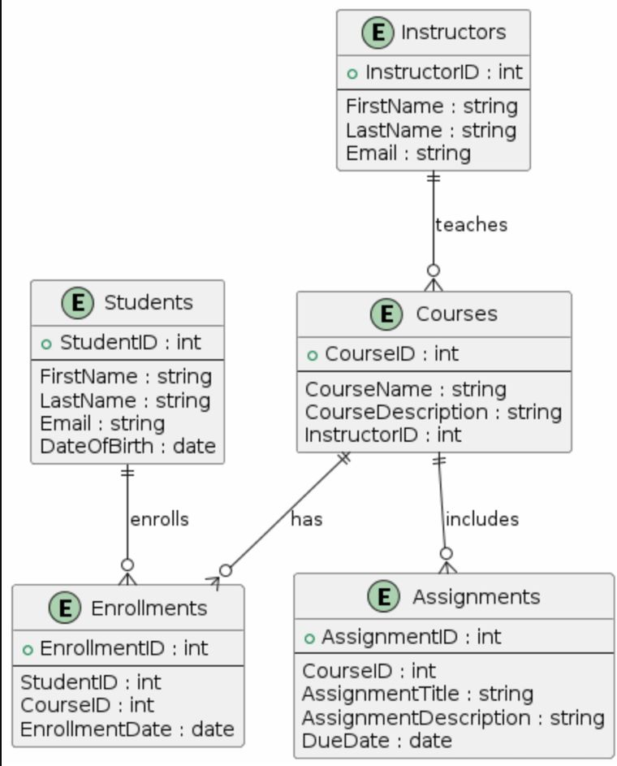
E-R Diagram

Slide 11



E-R Diagram Description
Students Table: Primary Key: StudentID
Instructors Table: Primary Key: InstructorID
Courses Table: Primary Key: CourseID, Foreign Key: InstructorID
Enrollments Table: Primary Key: EnrollmentID, Foreign Keys: StudentID, CourseID
Assignments Table: Primary Key: AssignmentID, Foreign Key: CourseID

Slide 12

Implementing DDL and DML
Implementing DDL and DML
Creation of Tables
Insertion of Data into Tables
Queries on Joins and Aggregate Functions

Slide 13

Example Queries
Retrieve Students with Enrolled Courses
Count Students Enrolled in Each Course
List Courses with Instructor' Name
Number of Assignments per Course
Detailed Enrollment Information
Students with Most Enrollments

Slide 14
Future Scope
Enhanced Features and Functionality: Interactive dashboards, gamification.
Data Analytics and Insights: Course effectiveness, sentiment analysis.
Scalability and Performance: Database optimization, cloud integration.
Security Enhancements: Data privacy, real-time monitoring, user authentication.

Slide 15



Conclusion
Impact: Transform educational experiences with advanced features, robust data analytics, and scalable architecture.
Scalability: Database optimization and cloud integration ensure system growth.
Security: Protect sensitive data with stringent measures.
Innovation: Continuously improve the platform with new technologies for a more effective education system.

Slide 16


Thanks!
suryaanshtomar_co22a7_53@dtu.ac.in
Sudhanshu_co22a7_49@dtu.ac.in
Suryaansh Tomar -2K22/CO/461
Sudhanshu – 2K22/CO/457

